Slide 1
Final Project – NBA MVP Prediction
DSC530-T302 Data Exploration and Analysis
Doug Evans

Slide 2
Introduction
This study poses the question if there is a common trend between the Most Valuable Player (MVP) award winners each year.
Over the years the NBA has award the MVP to the player that is deemed the most valuable to their team and in other words, the best player in the NBA that year.
There is a committee that votes on the players each season and our goal is to try and determine what qualifications that committee values the most.
A data base was found on Kaggle that tracks all the regular season shot locations from the 2003-2004 season to the 2023-2024 season.
Using this shot metric data, this study will determine if there is a common trend between the MVP winners' shots and why they won the MVP.

Slide 3
Data Analysis Process Plan
To get the widest range of MVP selection, this study will be using the 2003-2004, 2013-2014, and 2023-2024 seasons data to determine the MVP qualifications.
Each season will include the comparison between the first and second place finishers in that season.
This is to detect any possible difference between the winner and loser to figure out what the committee values more.

Slide 4
Variable Description
There are multiple descriptive variables that will be used in this study and there is a brief explanation given for each one. Here is the list of variables that will be used in this study:
PLAYER_NAME : The NBA players first and last name.
EVENT_TYPE : Two options for this variable, either Missed Shot or Made Shot
This study will filter the dataset to only include shots that were made
ACTION_TYPE : Type of shot the player took
Example : Jump Shot, Cutting Layup Shot, etc.
BASIC_ZONE : Area on the court where the shot was made
Example : In the Paint, Above the Break 3, etc.
SHOT_DISTANCE : How far away the shot was made from the basket
QUARTER : What quarter was the shot made in
MINS_LEFT : How many minutes were left in the quarter when the shot was made

Slide 5
2003-2004 Season
MVP : Kevin Garnett, 1219 Voting Points
Runner Up : Tim Duncan, 716 Voting Points

Slide 6
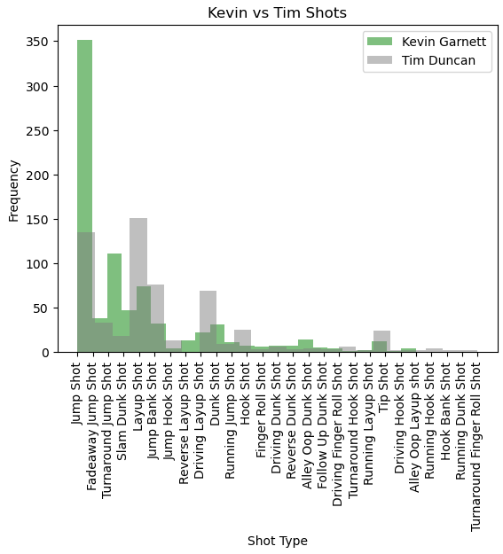

Shot Type Histogram
This graph shows the differences between the two players type of shots.
The important conclusion from this graph is that Kevin Garnett made a lot more Jump Shots than Tim Duncan did.
Below is the shot that both players took the most:

Slide 7
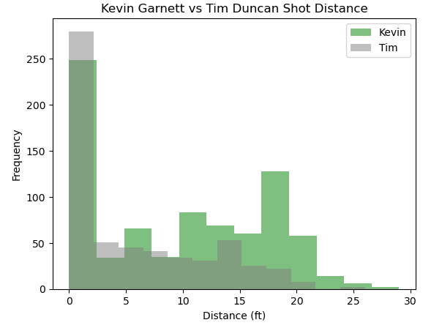
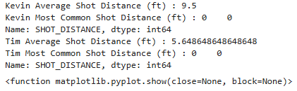
Shot Distance Histogram
This graph shows the differences between the two players distances of shots.
The important conclusion from this graph is that Kevin Garnett shot a lot further away from the basket than Tim Duncan did.
Below is the average shot distance and most common shot distance that both players took the most:

Slide 8
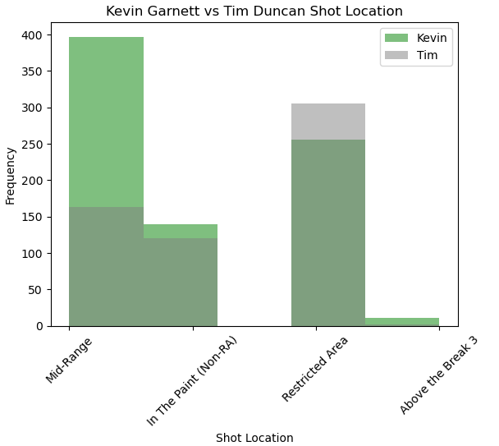

Shot Location Histogram
This graph shows the differences between the two players locations of shots.
The important conclusion from this graph is that Kevin Garnett shot a lot more Mid-Range shots than Tim Duncan did.
Below is the most common shot location that both players took the most:

Slide 9
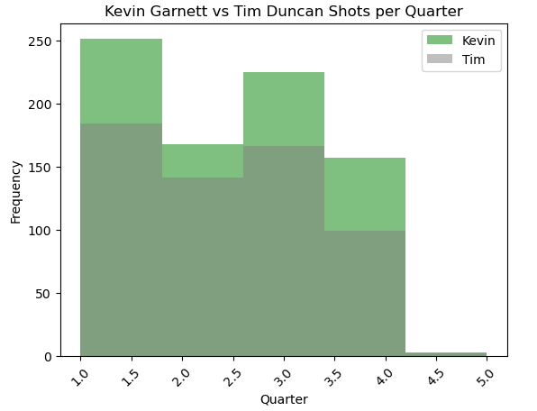

Shot Made Per Quarter Histogram
This graph shows the differences in made shots per quarter between the two players.
The important conclusion from this graph is that Kevin Garnett shot a lot more shots overall than Tim Duncan did.
Below is the most common quarter that each player made a shot in :

Slide 10
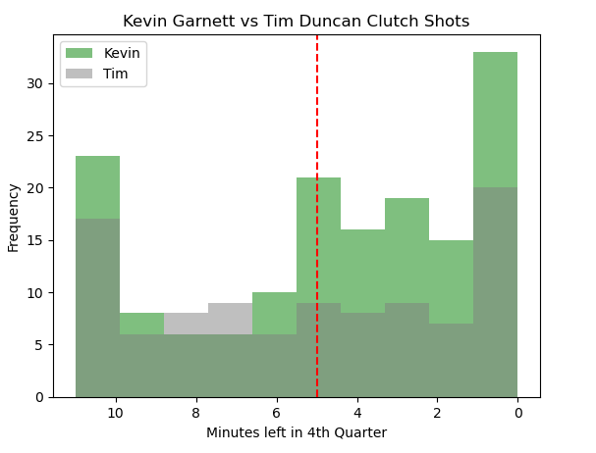
Clutch Shot Histogram
This graph shows the differences clutch shots made between both players.
Clutch shots are shots made in the last five minutes of the fourth quarter.
The red line is located at the 5-minute mark of the fourth quarter and everything after is considered a clutch shot.
The important conclusion from this graph is that Kevin Garnett made a lot more clutch shots than Tim Duncan.
Below is the most average time left in the fourth quarter when each player made a shot :

Slide 11
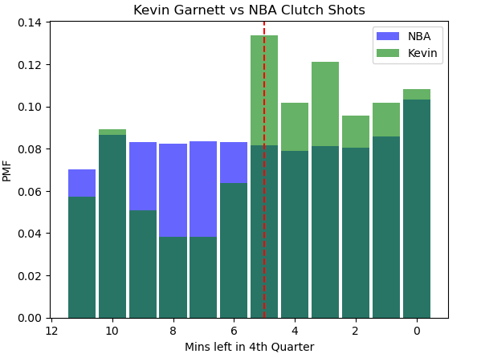
Clutch Shots PMF
This PMF studies the difference between the NBA as a whole and the MVP winner in clutch shots.
It is seen that Kevin Garnett made a lot of his shots in the fourth quarter towards the end of the game, which means he had more clutch shots and his team trusted him more in those close games.

Slide 12
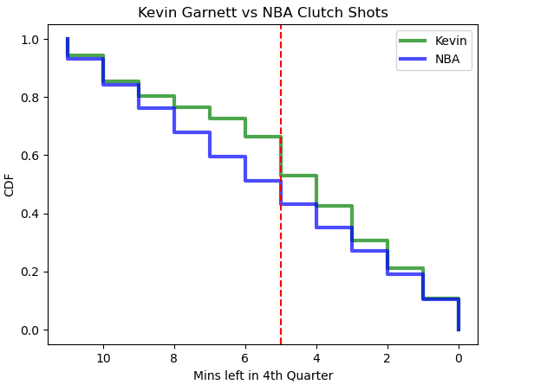
Clutch Shots CDF
This CDF studies the difference between the NBA as a whole and the MVP winner in clutch shots.
It is seen that Kevin Garnett had a larger probability to make a shot with less than five minutes than the rest of the NBA did.

Slide 13
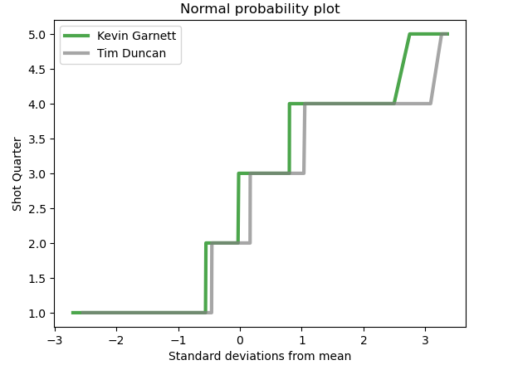
Shot Quarter Normal Probability Plot
This Normal Probability Plot is once again a comparison between the MVP winner Kevin Garnett and runner-up Tim Duncan.
This plot is comparing the two for which one scored during each quarter.
Usually there are four quarters in a basketball game, however in some games whenever the score is tied, they play an extra quarter to determine the winner.
Both players seem to make a majority of their shots in the 2nd quarter of the game.
However, for Kevin Garnett the 4th quarter shots are closer to the mean than Tim Duncan.

Slide 14
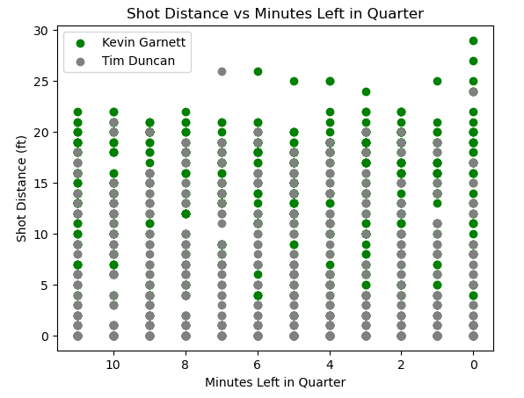

MVP vs Runner Up Scatter Plot
This scatter plot is comparing the two players and how far away they were shooting with a specific time left in each quarter.
A correlation value was gathered for each player:
These correlation values indicate neither a strong positive or negative relationship, however it does show that Kevin Garnett is slightly more positive than Tim Duncan.
This means that as the time decreases in the game, his shots get further away from the basket.

Slide 15
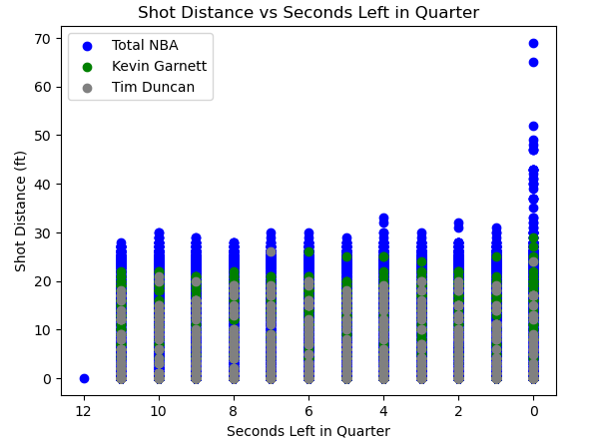

MVP and Runner-Up vs NBA Scatter Plot
This scatter plot is the same comparison however the whole NBA is included in this one as well.
A correlation value was gathered for each player and the NBA:
These correlation values indicate neither a strong positive or negative relationship for all parties, however it does show that both Tim and Kevin are slightly more positive than the NBA.
This means that as the time decreases in the game, their shots get further from the basket than the NBA does.

Slide 16
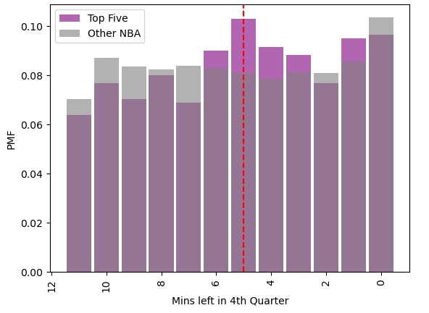

Hypothesis Testing
Now it is time to perform a hypothesis test using the t-statistic and the p-value to determine committee's we can reject the null hypothesis.
The null hypothesis is:
There is no difference in the committee's selection when it comes to clutch shots
The alternative hypothesis is:
There is a difference in how the committee views players who makes clutch shots and those who do not.
In this study, instead of comparing the MVP and runner up with the NBA, we will now group together the top five vote getters for the year against the NBA to determine if the null hypothesis can be rejected.
According to the p-value the null hypothesis can be rejected since it is less than .05.

Slide 17
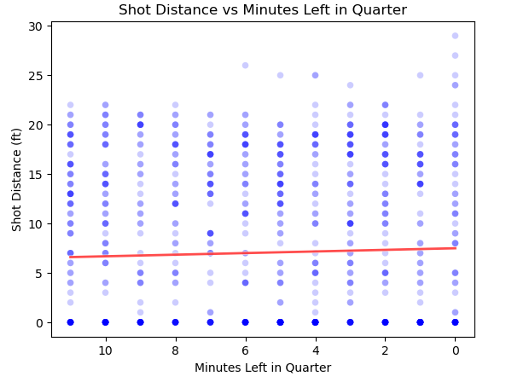

Regression Analysis
Lastly, a regression analysis is performed to determine how much the minutes left in the quarter affects the shot distance for the MVP winner.
The intercept and the slope were calculated for the line of best fit and it was discovered that there was a slight positive slope which means that as the quarter ends, Kevin Garnett shoots from further away.

Slide 18
2013-2014 Season
MVP : Kevin Durant (KD), 1232 Voting Points
Runner Up : Lebron James, 891 Voting Points

Slide 19
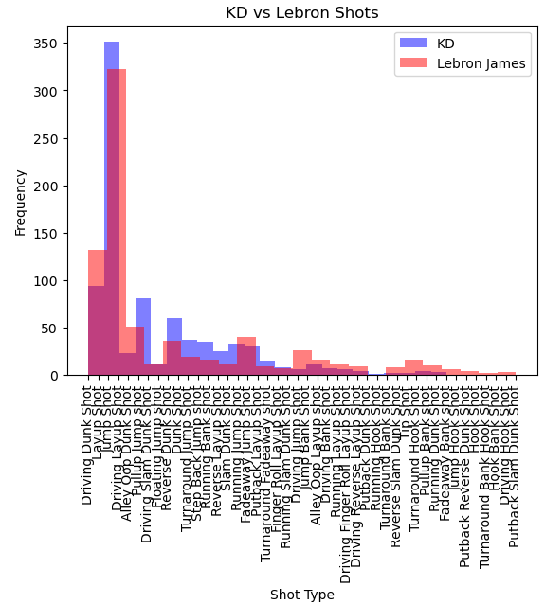

Shot Type Histogram
This graph shows the differences between the two players type of shots.
The important conclusion from this graph is that Kevin Durant made a lot more Jump Shots than Lebron James did and had a more versed shooting chart than Lebron
Below is the shot that both players took the most:

Slide 20
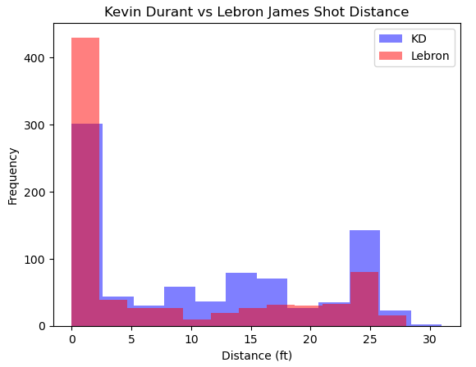
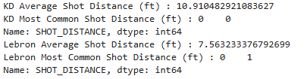
Shot Distance Histogram
This graph shows the differences between the two players distances of shots.
The important conclusion from this graph is that Kevin Durant shot a lot further away from the basket than Lebron James did.
Below is the average shot distance and most common shot distance that both players took the most:

Slide 21
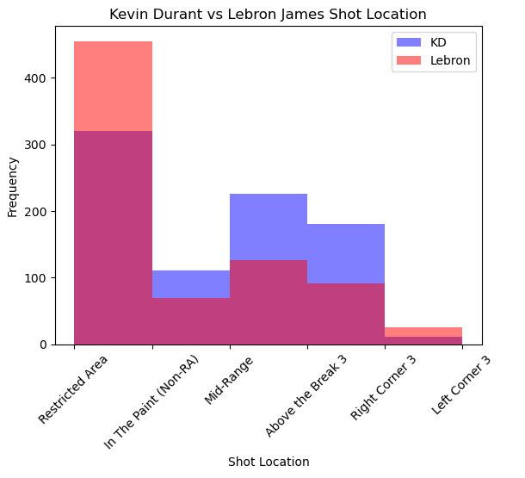

Shot Location Histogram
This graph shows the differences between the two players locations of shots.
The important conclusion from this graph is that Kevin Durant shot a lot more outside of the Restricted Area than Lebron James did.
Below is the most common shot location that both players took the most:

Slide 22
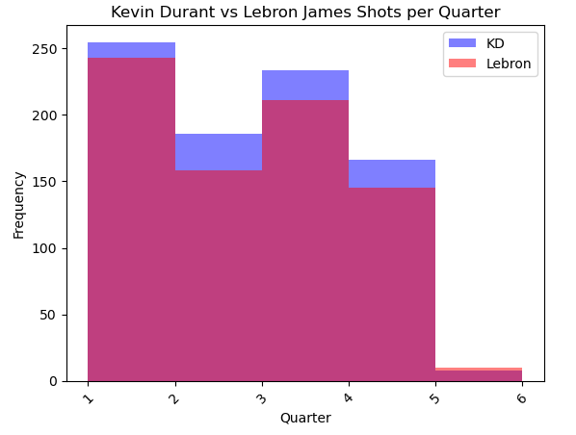

Shot Made Per Quarter Histogram
This graph shows the differences in made shots per quarter between the two players.
The important conclusion from this graph is that Kevin Durant made a lot more shots overall than Lebron James did.
Below is the most common quarter that each player made a shot in :

Slide 23
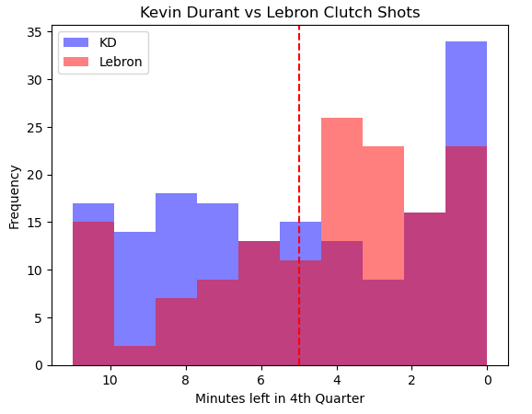
Clutch Shot Histogram
This graph shows the differences clutch shots made between both players.
Clutch shots are shots made in the last five minutes of the fourth quarter.
The red line is located at the 5-minute mark of the fourth quarter and everything after is considered a clutch shot.
The important conclusion from this graph is that Kevin Durant made a lot more clutch shots within the last 3 minutes than Lebron James did.
Lebron made a lot more shots than KD did in the 3-4 minutes left range
Below is the most average time left in the fourth quarter when each player made a shot :

Slide 24
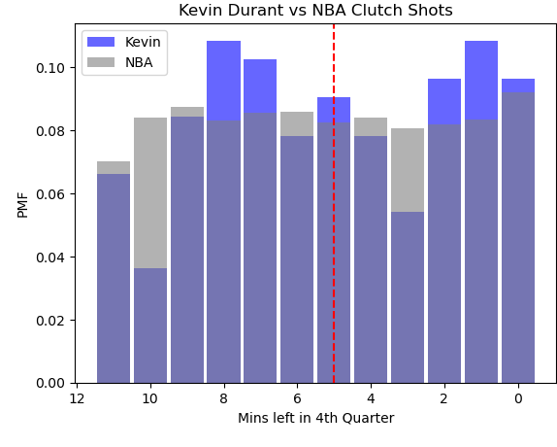
Clutch Shots PMF
This PMF studies the difference between the NBA as a whole and the MVP winner in clutch shots.
It is seen that Kevin Durant made a lot of his shots in the fourth quarter towards the end of the game, which means he had more clutch shots and his team trusted him more in those close games.

Slide 25
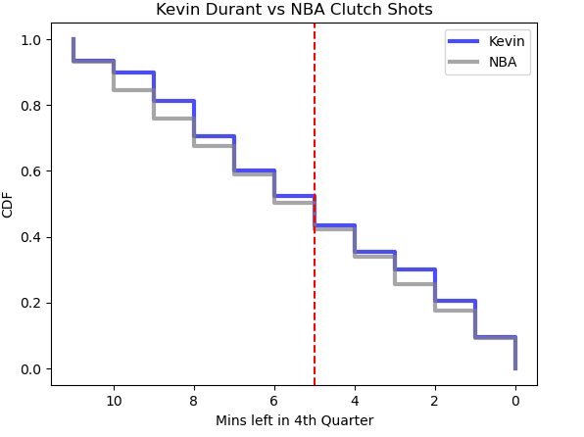
Clutch Shots CDF
This CDF studies the difference between the NBA as a whole and the MVP winner in clutch shots.
It is seen that Kevin Durant had a larger probability to make a shot with less than five minutes than the rest of the NBA did.

Slide 26
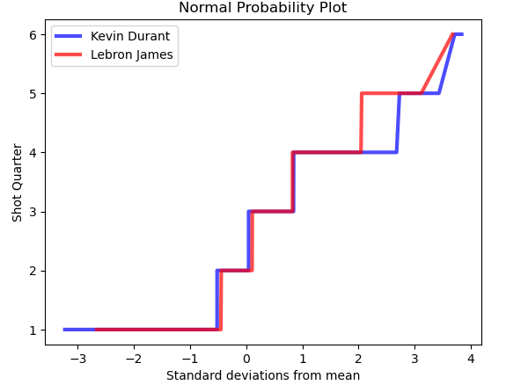
Shot Quarter Normal Probability Plot
This Normal Probability Plot is once again a comparison between the MVP winner Kevin Durant and runner-up Lebron James.
This plot is comparing the two for which one scored during each quarter.
Usually there are four quarters in a basketball game, however in some games whenever the score is tied, they play an extra quarter to determine the winner.
Both players seem to make a majority of their shots in the 2nd quarter of the game.
However, for Kevin Durant the 4th quarter shots are further away from the mean than Lebron James.
This could explain why the vote was closer this study than last study

Slide 27
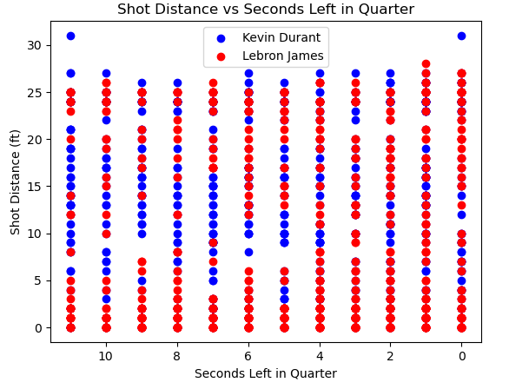

MVP vs Runner Up Scatter Plot
This scatter plot is comparing the two players and how far away they were shooting with a specific time left in each quarter.
A correlation value was gathered for each player:
These correlation values indicate neither a strong positive or negative relationship, however it does show that Kevin Durant is more positive than Lebron James.
This means that as the time decreases in the game, his shots get further away from the basket.

Slide 28
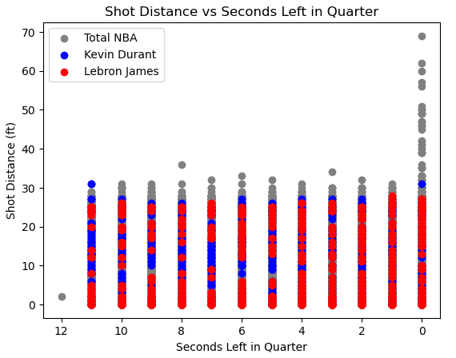

MVP and Runner-Up vs NBA Scatter Plot
This scatter plot is the same comparison however the whole NBA is included in this one as well.
A correlation value was gathered for each player and the NBA:
These correlation values indicate neither a strong positive or negative relationship for all parties, however it does show that Lebron does have a more negative correlation than the NBA.
This means that as the time decreases in the game, Lebron’s shots get closer to the basket than the NBA does.

Slide 29
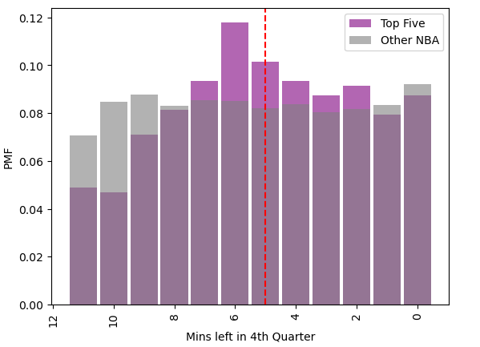

Hypothesis Testing
Now it is time to perform a hypothesis test using the t-statistic and the p-value to determine committee's we can reject the null hypothesis.
The null hypothesis is:
There is no difference in the committee's selection when it comes to clutch shots
The alternative hypothesis is:
There is a difference in how the committee views players who makes clutch shots and those who do not.
In this study, instead of comparing the MVP and runner up with the NBA, we will now group together the top five vote getters for the year against the NBA to determine if the null hypothesis can be rejected.
According to the p-value the null hypothesis can be rejected since it is less than .05.

Slide 30
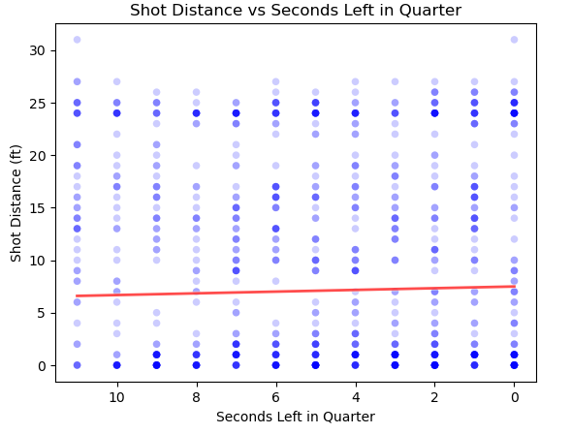

Regression Analysis
Lastly, a regression analysis is performed to determine how much the minutes left in the quarter affects the shot distance for the MVP winner.
The intercept and the slope were calculated for the line of best fit and it was discovered that there was a slight positive slope which means that as the quarter ends, Kevin Durant shoots from further away.

Slide 31
2023-2024 Season
MVP : Nikola Jokic, 926 Voting Points
Runner Up : Shai Gilgeous-Alexander (SGA), 640 Voting Points

Slide 32
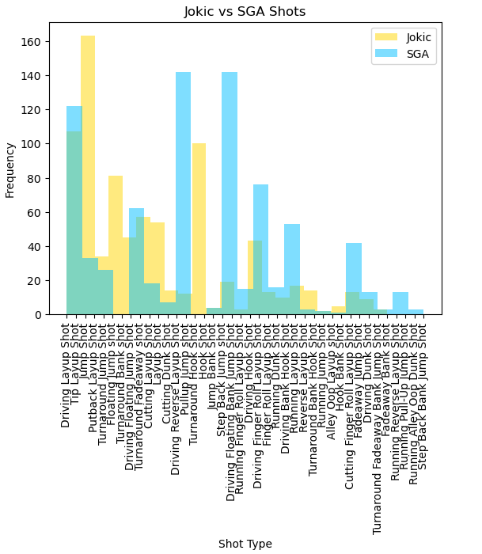

Shot Type Histogram
This graph shows the differences between the two players type of shots.
The important conclusion from this graph is that Jokic made a lot more Jump Shots than SGA did.
Below is the shot that both players took the most:

Slide 33
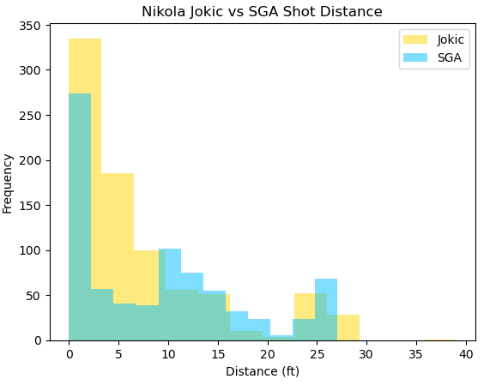
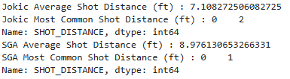
Shot Distance Histogram
This graph shows the differences between the two players distances of shots.
The important conclusion from this graph is that in difference to the previous seasons, the MVP winner shot closer to the basket than the runner up did.
Below is the average shot distance and most common shot distance that both players took the most:

Slide 34
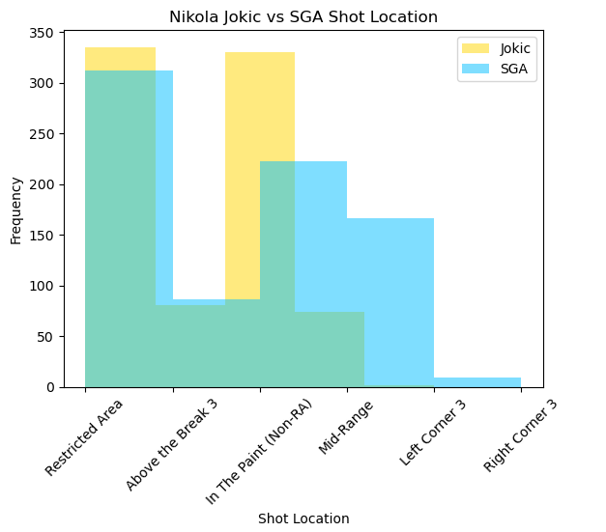

Shot Location Histogram
This graph shows the differences between the two players locations of shots.
The important conclusion from this graph is that Jokic shot a lot more In The Paint shots than SGA did.
Below is the most common shot location that both players took the most:

Slide 35
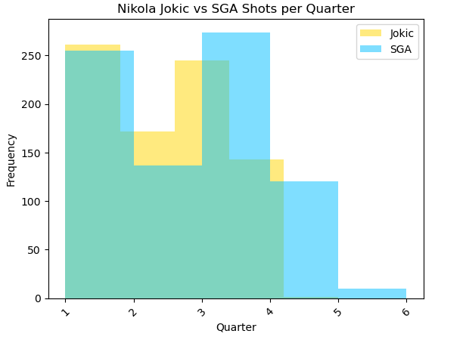

Shot Made Per Quarter Histogram
This graph shows the differences in made shots per quarter between the two players.
The important conclusion from this graph is that Jokic made most of his shots in the first quarter while SGA made his in the third quarter.
Below is the most common quarter that each player made a shot in :

Slide 36
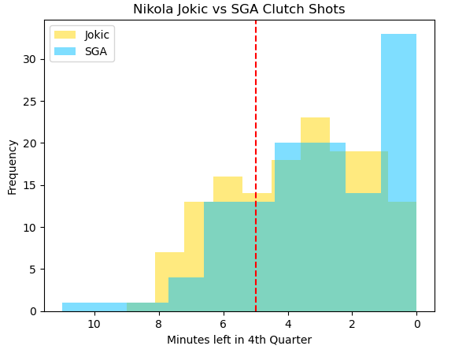
Clutch Shot Histogram
This graph shows the differences clutch shots made between both players.
Clutch shots are shots made in the last five minutes of the fourth quarter.
The red line is located at the 5-minute mark of the fourth quarter and everything after is considered a clutch shot.
The important conclusion from this graph is that Jokic and SGA were relatively even in clutch shots.
However, clearly SGA made way more shots toward s the end of the game than Jokic.
Below is the most average time left in the fourth quarter when each player made a shot :

Slide 37
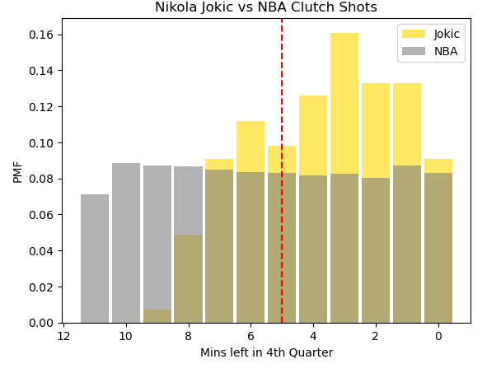
Clutch Shots PMF
This PMF studies the difference between the NBA as a whole and the MVP winner in clutch shots.
It is seen that Jokic made a lot of his shots in the fourth quarter towards the end of the game, which means he had more clutch shots and his team trusted him more in those close games.

Slide 38
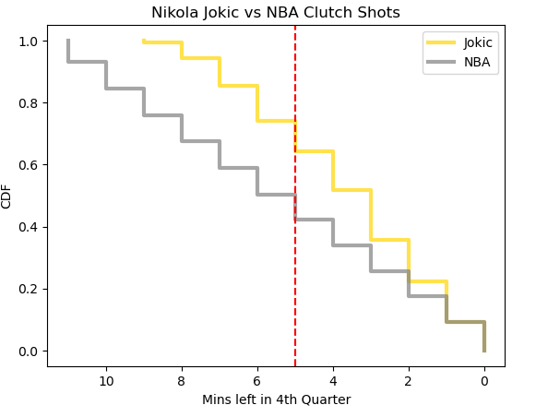
Clutch Shots CDF
This CDF studies the difference between the NBA as a whole and the MVP winner in clutch shots.
It is seen that Jokic had a way larger probability to make a shot with less than five minutes than the rest of the NBA did.
This could show the increasing priority of clutch shots when it comes to MVP voting.

Slide 39
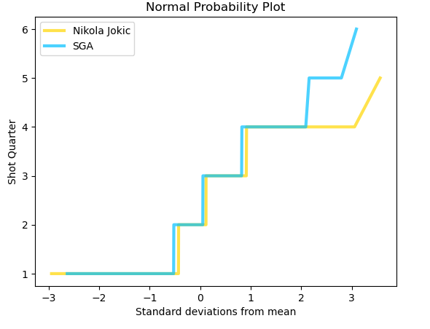
Shot Quarter Normal Probability Plot
This Normal Probability Plot is once again a comparison between the MVP winner Nikola Jokic and runner-up SGA.
This plot is comparing the two for which one scored during each quarter.
Usually there are four quarters in a basketball game, however in some games whenever the score is tied, they play an extra quarter to determine the winner.
Both players seem to make a majority of their shots in the 2nd quarter of the game.
However, for SGA the 4th quarter shots are closer to the mean than Jokic
This could explain why this vote was so much closer than the previous two studies

Slide 40
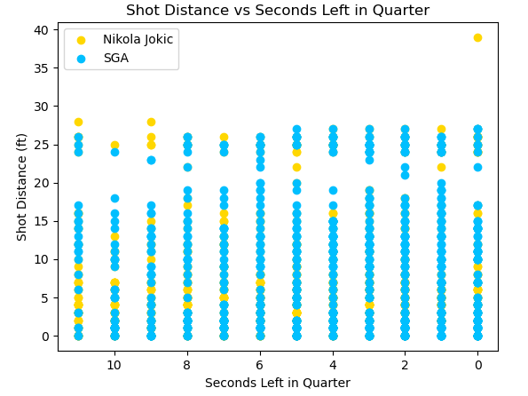

MVP vs Runner Up Scatter Plot
This scatter plot is comparing the two players and how far away they were shooting with a specific time left in each quarter.
A correlation value was gathered for each player:
These correlation values indicate neither a strong positive or negative relationship, however it does show that Nikola Jokic is slightly more negative than SGA.
This means that as the time decreases in the game, his shots get closer to the basket.

Slide 41
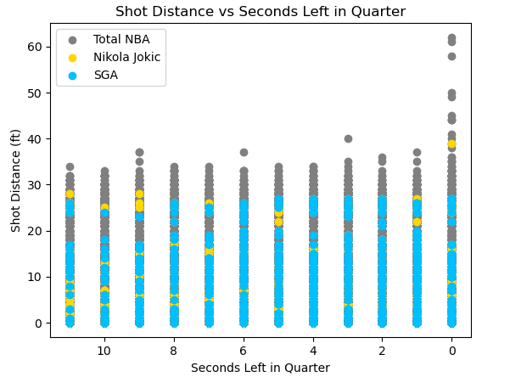

MVP and Runner-Up vs NBA Scatter Plot
This scatter plot is the same comparison however the whole NBA is included in this one as well.
A correlation value was gathered for each player and the NBA:
These correlation values indicate neither a strong positive or negative relationship for all parties, however it does show that for Jokic, his is more negative than the NBA.
This means that as the time decreases in the game, his shots get closer to the basket than the NBA does.

Slide 42
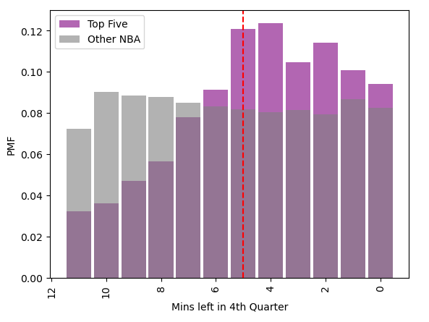
Hypothesis Testing
Now it is time to perform a hypothesis test using the t-statistic and the p-value to determine committee's we can reject the null hypothesis.
The null hypothesis is:
There is no difference in the committee's selection when it comes to clutch shots
The alternative hypothesis is:
There is a difference in how the committee views players who makes clutch shots and those who do not.
In this study, instead of comparing the MVP and runner up with the NBA, we will now group together the top five vote getters for the year against the NBA to determine if the null hypothesis can be rejected.
According to the p-value the null hypothesis can be rejected since it is less than .05.

Slide 43
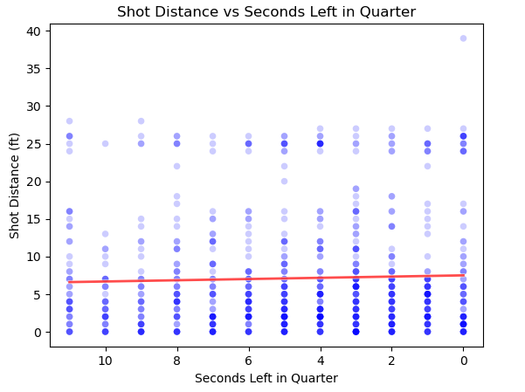

Regression Analysis
Lastly, a regression analysis is performed to determine how much the minutes left in the quarter affects the shot distance for the MVP winner.
The intercept and the slope were calculated for the line of best fit and it was discovered that there was a slight positive slope which means that as the quarter ends, Jokic shoots closer to the basket.

Slide 44
Conclusion
After performing these analyses on multipole seasons, one common trend that has been found is that the committee values clutch performers very highly.
The NBA is constantly changing and evolving how they play the game, but one thing has stood the test of time, clutch performers get the most reorganization.
Recently, the NBA has created an award for the most clutch performer during the season, and my prediction is that the winner of that award should also be close to winning the MVP as well.
Other metrics like shot location also help as well, however with this study it was concluded that if the person is performing well in clutch situations than there is a strong chance that person will win the MVP award.

Slide 45
Challenges/Next Steps
This study was well versed in the offensive side of the ball, however a big gap in this study is that defensive attributes were not considered.
Therefore, the next steps in this study is to incorporate defensive stats into this study to determine how much being a good defensive player helps with MVP voting.
Also, in order to enhance the offensive study, another comparison that could be made is within the MVP players position group and how well they performed compared to others.
The challenges that were found in this study is the correlation plots as there needs to be outside factors since all the shots are well correlated with each other, more research will be put into that area of this study.

Slide 46
References
https://www.kaggle.com/datasets/mexwell/nba-shots?resource=download&select=NBA_2004_Shots.csv
https://www.basketball-reference.com/awards/awards_2024.html
https://www.basketball-reference.com/awards/awards_2014.html
https://www.basketball-reference.com/awards/awards_2004.html

